Slide 1
Leadership Positions
Troop 492

Slide 2
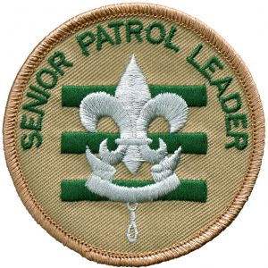
Senior Patrol Leader
With three green bars behind the Scout emblem, the senior patrol leader’s shoulder patch symbolizes one of the oldest leadership positions in Scouting. The Boy Scouts of America has long recognized the senior patrol leader as the highest youth leadership position in a troop. They are the primary link between a troop’s Scouts and its adult leaders. They shoulder the responsibility for leading meetings of the troop and the patrol leaders’ council and provide valuable leadership in planning and carrying out the troop’s program of outdoor activities, service projects, and events.
Responsibilities
runs all troop meetings, events, activities, and the annual program planning conference
runs the patrol leaders’ council (PLC) meetings
appoints other troop junior leaders with the advice and counsel of the Scoutmaster
assigns duties and responsibilities to junior leaders
assists the Scoutmaster with junior leader training
sets a good example
wears the Scout uniform correctly
lives by the Scout Oath and Law
shows Scout spirit

Slide 3
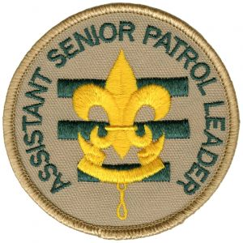
Assistant Senior Patrol Leader
The assistant senior patrol leader is the second highest youth leadership position in the troop, working closely with the senior patrol leader to help the troop move forward. The assistant senior patrol leader acts as the senior patrol leader in the absence of the senior patrol leader or when called upon, and provides leadership to other youth leaders in the troop. The assistant senior patrol leader is appointed by the senior patrol leader under the guidance of the Scoutmaster.
Responsibilities
helps the senior patrol leader lead meetings and activities
runs the troop in the absence of the senior patrol leader
helps train and supervise the troop scribe, quartermaster, instructor, librarian,
historian, webmaster, chaplain aide, and OA representative
serves as a member of the patrol leaders’ council
sets a good example
wears the Scout uniform correctly
lives by the Scout Oath and Law
shows Scout spirit
lends a hand controlling the patrols and building patrol spirit

Slide 4
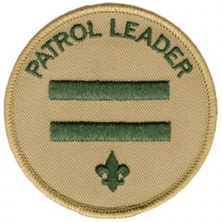
Patrol Leader
The patrol leader is the patrol’s key leader, representing the patrol at all patrol leaders’ council meetings and the annual program planning conference, and keeping patrol members informed of decisions made. Patrol leaders carry out planning, leading, and evaluating patrol meetings and activities, and assure patrols are prepared to participate in all troop activities. They keep their patrol intact so they can work together and share responsibilities to get things done. It is incumbent upon them to be a good example for the members of their patrol and the rest of the troop.
Responsibilities
plans and leads patrol meetings and activities
keeps patrol members informed
assigns each patrol member a specific duty
represents his patrol at all patrol leaders’ council meetings and
the annual program planning conference
prepares the patrol to participate in all troop activities
works with other troop leaders to make the troop run well
knows the abilities of each patrol member
sets a good example
wears the Scout uniform correctly
lives by the Scout Oath and Law
shows and develops patrol spirit

Slide 5
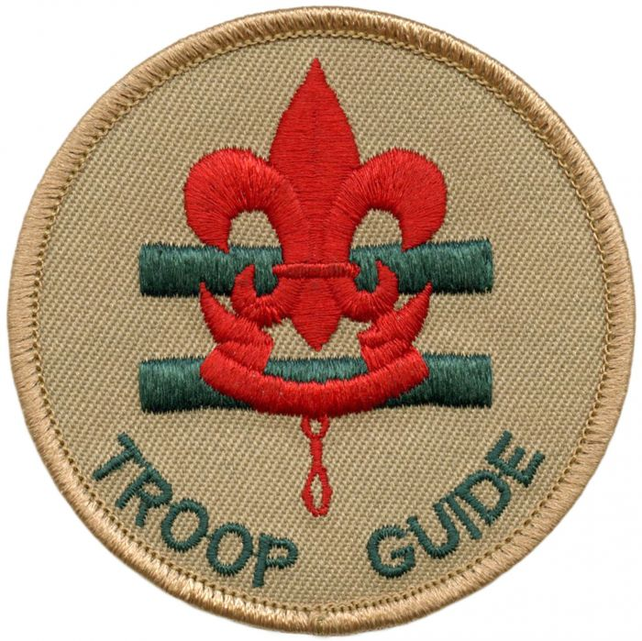
Troop Guide
Troop guides serve as both a leader and a mentor to the members of the new-Scout patrol. They should be an older Scout who holds at least the First Class rank and with younger Scouts. The troop guide helps the patrol leader of the new-Scout patrol lead their patrol, so they can develop into a well-functioning group, working together harmoniously and productively.
Responsibilities
introduces new Scouts to troop operations
guides new Scouts from harassment by older Scouts
helps new Scouts towards earning the First Class rank
teaches basic Scout skills
coaches the patrol leader of the new-Scout patrol on his duties
works with the patrol leader at patrol leaders’ council meetings
attends patrol leaders’ council meetings with the patrol leader
of the new-Scout patrol
counsels individuals Scouts on Scouting challenges
sets a good example
wears the Scout uniform correctly
lives by the Scout Oath and Law
shows Scout spirit

Slide 6
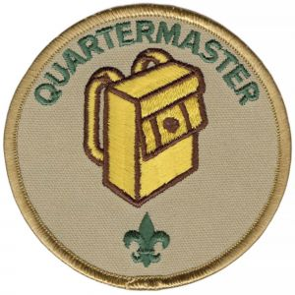
Quartermaster
Quartermasters serve as the troop’s supply boss. They keep an inventory of troop equipment and see that the gear is in good condition. They work with patrol quartermasters as they check out equipment and return it. At meetings of the patrol leaders’ council they report on the status of equipment in need of replacement or repair. In carrying out their responsibilities, they may have the guidance of a member of the troop committee.
Responsibilities
keeps records on patrol and troop equipment
makes sure equipment is in good working condition
issues equipment and makes sure it is returned in good condition
makes suggestions for new or replacement items
works with the troop committee member responsible for equipment
sets a good example
wears the Scout uniform correctly
lives by the Scout Oath and Law
shows Scout spirit

Slide 7
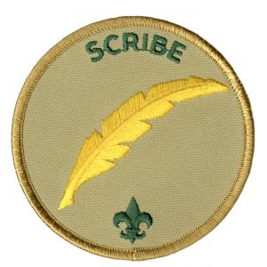
Scribe
The scribe is the troop’s secretary. Though not a voting member, they attend meetings of the patrol leaders’ council and keep a record of the discussions. They cooperate with the patrol scribes to record attendance and dues payments at troop meetings and to maintain troop advancement records. The troop scribe may be assisted by a member of the troop committee.
Responsibilities
attends and keeps a log of patrol leaders’ council meetings
records individual Scout attendance and dues payments
records individual Scout advancement progress
works with the troop committee member responsible for
records and finance
sets a good example
wears the Scout uniform correctly
lives by the Scout Oath and Law
shows Scout spirit

Slide 8
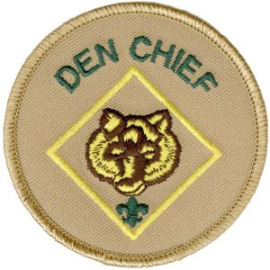
Den Chief
Den chiefs are Scouts who assist a Cub Scout den leader or Webelos den leader. They are selected by the senior patrol leader and Scoutmaster, and approved by the cubmaster and the pack committee for recommendation to the den leader. Den chiefs help Cub Scouts advance through Cub Scout ranks and encourage Cub Scouts to join a troop upon graduation.
Responsibilities
knows the purposes of Cub Scouting
helps Cub Scouts achieve the purposes of Cub Scouting
serves as the activities assistant at den meetings
sets a good example through attitude and uniforming
is a friend to the members of the den
helps lead weekly den meetings
helps the den in its part of the monthly pack meeting.
knows the importance of the monthly theme and pack meeting plans
meets regularly with the den leader to review den and pack meeting plans
meets as needed with adult members of the den, pack, and troop
receives training from the den leader (and cubmaster or assistant cubmaster)
takes Den Chief Training
encourages Cub Scouts to become Webelos Scouts when they are eligible
encourages Webelos Scouts to join a Scout troop upon graduation
helps the denner and assistant denner to be leaders.
wears the Scout uniform correctly
lives by the Scout Oath and Law
shows Scout spirit

Slide 9
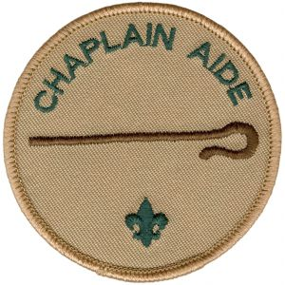
Chaplain Aide
Chaplain aides assist the troop chaplain (usually an adult from the troop committee or the chartered organization) in serving the religious needs of the troop. They lead the troop in opening or closing prayer and mealtime blessings. Chaplain aides ensure that religious holidays are considered during the troop’s program planning process and promotes the BSA’s religious emblems program.
Responsibilities
assists the troop chaplain with religious services at troop activities
encourages troop members to strengthen their own relationships with God through personal prayer and devotion and participation in religious activities appropriate to their faith
tells Scouts about the Religious Emblems program for their faith at least once a year
helps recognize troop members who receive their religious emblems, (such as at a court of honor)
makes sure religious holidays are considered during the troop program planning process
helps plan for religious observance in troop activities
encourages saying grace at meals while camping or at other activities
helps promote annual Scout Sunday or Scout Sabbath
sets a good example
wears the Scout uniform correctly
lives by the Scout Oath and Law
shows Scout spirit

Slide 10
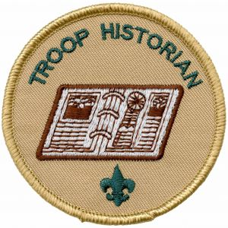
Historian
The historian collects, assembles, and preserves troop photographs, news stories, trophies, flags, scrapbooks, awards, and other memorabilia, and makes materials available for Scouting activities, courts of honor, the media, and troop history projects.
Responsibilities
gathers photos and facts about troop activities and keeps them in a historical file or scrapbook
takes care of troop trophies, ribbons, and souvenirs of troop activities
keeps information about former members of the troop
sets a good example
wears the Scout uniform correctly
lives by the Scout Oath and Law
shows Scout spirit

Slide 11
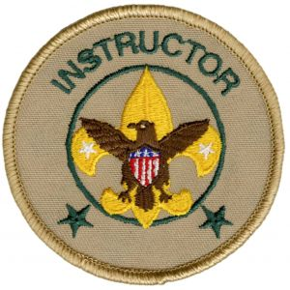
Instructor
Each instructor is an older troop member proficient in a Scouting skill who must also have the ability to teach that skill to others. An instructor typically teaches subjects that Scouts are eager to learn—especially those such as first aid, camping, and backpacking—that are required for outdoor activities and rank advancement. A troop can have more than one instructor.
Responsibilities
teaches basic Scouting skills
schedule/coordinate merit badge counselor(s)
for troop/Scout instruction
sets a good example
wears the Scout uniform correctly
lives by the Scout Oath and Law
shows Scout spirit

Slide 12
Librarian
Troop librarians oversee the care and use of troop books, pamphlets, magazines, audiovisuals, and merit badge counselor lists. They check out these materials to Scouts and leaders and maintain records to ensure that everything is returned. They may also suggest the acquisition of new literature and report the need to repair or replace any current holdings.
Responsibilities
sets up and takes care of the troop library
keeps records of books and pamphlets owned by the troop
adds new or replacement items as needed
keeps books and pamphlets available for borrowing
keeps a system for checking books and pamphlets in and
out, and follows up on late returns
sets a good example
wears the Scout uniform correctly
lives by the Scout Oath and Law
shows Scout spirit

Slide 13
Troop Webmaster
Troop webmasters are responsible for maintaining the troop’s website. They make sure that information posted on the website is correct and up to date and that the privacy of youth and adult troop members is protected. A member of the troop committee may assist them with their work.
Responsibilities
works with various unit members on needed topics
ensures the website is as youth-run as possible
maintains the website as needed
sets a good example
correctly wears the Scout uniform correctly
shows Scout spirit

Slide 14
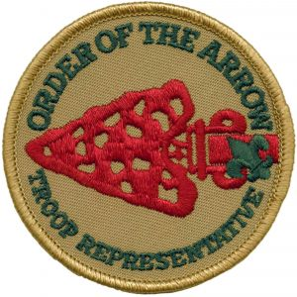
Order of the Arrow Troop Representative
Order of the Arrow representatives serve as a communication link between the troop and the local Order of the Arrow lodge. By enhancing the image of the Order as a service arm to the troop, they promote the OA, encourage Scouts to take part in all sorts of camping opportunities, and helps pave the way for older Scouts to become involved in high-adventure programs.
Responsibilities
attends troop, chapter and lodge meetings regularly as a youth representative of the troop and Order
serves as a two-way communication link between the troop and the lodge or chapter
arranges with the lodge or chapter election team to conduct an annual Order of the Arrow election for the troop at a time approved by the patrol leaders council
arranges with the lodge or chapter for at least one camp promotion visit to the unit annually
makes at least one high adventure presentation to the troop, to include the OA programs, annually
participates in troop courts of honor, as requested by the senior patrol leader, by recognizing: high adventure participation of troop members, induction of new OA members, changes in OA honors of troop members, and other appropriate activities
coordinates the ordeal induction process for newly elected candidates by: ensuring they know the time and location of the ordeal, providing information of what to bring to the ordeal, assisting (as needed) in arranging transportation to the ordeal, and offering assistance (as needed) to the lodge in the ordeal process
assists current ordeal members in the troop in sealing their membership by becoming brotherhood members by: ensuring they know the time and location of brotherhood opportunities, assisting (as needed) in arranging transportation to the brotherhood opportunities, and offering assistance to the lodge (as needed) in the brotherhood process
offers periodic training and discussions of OA principles, symbolism, and the Legend as needed by and appropriate for the troop members of the Order, at the discretion of the PLC
assists the troop (as appropriate) as a trainer of leadership and outdoor skills.
advocates environmental stewardship and Leave No Trace camping
sets a good example by: wearing the Scout uniform correctly, showing Scout spirit
and living by the Scout Oath, the Scout law, and the OA Obligation

Slide 15
Outdoor Ethic Guide
Outdoor ethics guides help troops plan and conduct an outdoor program that emphasizes effectively practicing the Outdoor Code, the Leave No Trace principles, and the Tread Lightly! principles. Guides work to help Scouts improve their outdoor ethics decision-making skills to help minimize impacts as they hike, camp, and participate in other outdoor activities. In particular, they should support Scouts who are working to complete the relevant requirements for the Tenderfoot, Second Class, and First Class ranks.
Responsibilities
assures the troop adheres to the Principles of Leave No Trace,
Tread Lightly, and the Outdoor Code
sets a good example
wears the Scout uniform correctly
lives by the Scout Oath and Law
shows Scout spirit

Slide 16
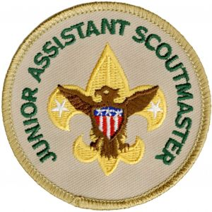
Junior Assistant Scoutmaster
A Scout at least 16 years of age who has shown outstanding leadership skills may be appointed by the Scoutmaster to serve as a junior assistant Scoutmaster (JASM). The junior assistant Scoutmaster functions just like an assistant Scoutmaster (except for leadership responsibilities reserved for adults 18 years of age or older). In this capacity, junior assistant Scoutmasters (a troop may have more than one) follow the guidance of the Scoutmaster in providing support and supervision to other youth leaders in the troop. Upon their 18th birthday, a junior assistant Scoutmaster will be eligible to become an assistant Scoutmaster.
Responsibilities
performs duties as assigned by the Scoutmaster.
sets a good example.
wears the Scout uniform correctly
lives by the Scout Oath and Law.
shows Scout spirit

